Slide 1




EXECUTIVE REPORT MANAGER
LOGIN
Remember Me
Login

Slide 2
EXECUTIVE REPORT MANAGER
LOGIN
Invalid Credentials. Please contact the Administrator.
Remember Me
Login

Slide 3


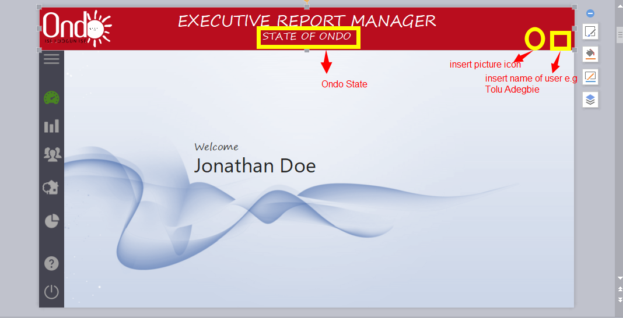




EXECUTIVE REPORT MANAGER
STATE OF ONDO
Welcome
Jonathan Doe

Slide 4
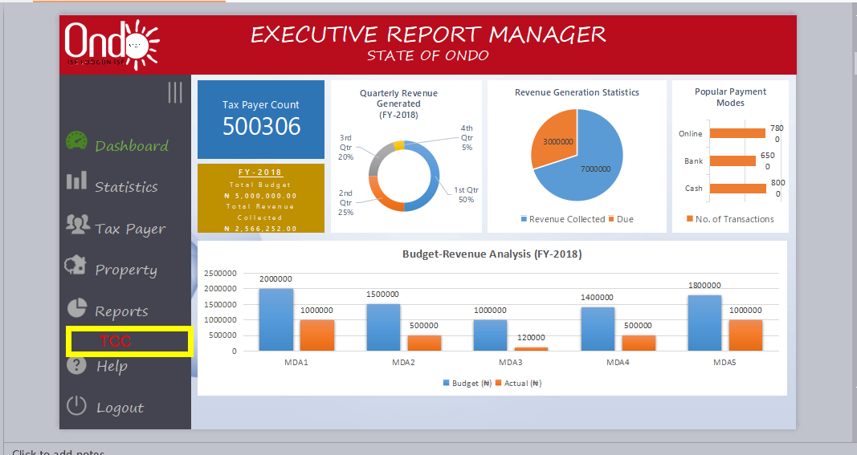
EXECUTIVE REPORT MANAGER
STATE OF ONDO
Tax Payer Count
500306
Dashboard
Statistics
Tax Payer
Property
Reports
FY-2018
Total Budget
₦ 5,000,000.00
Total Revenue Collected
₦ 2,566,252.00
Help
Logout

Slide 5
EXECUTIVE REPORT MANAGER
STATE OF ONDO
Tax Payer Count
500306
FY-2018
Total Budget
₦ 5,000,000.00
Total Revenue Collected
₦ 2,566,252.00

Slide 6
EXECUTIVE REPORT MANAGER
STATE OF ONDO
Tax Payer Count
500306
Payment Mode No. of Transactions Total Value
Cash 50122 ₦ 5,565,545.25
Online 50122 ₦ 5,565,545.25
Bank 50122 ₦ 5,565,545.25
FY-2018
Total Budget
₦ 5,000,000.00
Total Revenue Collected
₦ 2,566,252.00
Ok
Print

Slide 7

pie charts aand doughnut chats to be replaced with guage charts and bullet chart,in refrence to the fact that any collection that surpasses its budget be easily identified with the above stated .
EXECUTIVE REPORT MANAGER
STATE OF ONDO
Tax Payer Count
500306
FY-2018
Total Budget
₦ 5,000,000.00
Total Revenue Collected
₦ 2,566,252.00

Slide 8
EXECUTIVE REPORT MANAGER
STATE OF ONDO
Highest Collection
₦1,800,000.32
Aug 2018

Slide 9
EXECUTIVE REPORT MANAGER
STATE OF ONDO
Budget vs. Revenue
Revenue
Banks
RRA
EEF
Data Explorer
Timeline
MDA
All
Select
FY
2018
5 Selected
Total Summary
Filtered Summary
₦ 152,354.96
₦ 52,354.96
₦ 100,000.96
Total Budget
Total Collection
Arrears
₦ 152,354.96
₦ 52,354.96
₦ 100,000.96
Total
₦ 152,354.96
Total Budget
Total Collection
Arrears
Total
₦ 152,354.96
MDA Budget Revenue Collected Arrears Deviation
ACCELERATED POVERTY ALLEVIATION AGENCY(APAA) ₦ 152,354.96 ₦ 52,354.96 ₦ 100,000.96 33.33 %
ACCELERATED POVERTY ALLEVIATION AGENCY(APAA) ₦ 152,354.96 ₦ 52,354.96 ₦ 100,000.96 33.33 %
ACCELERATED POVERTY ALLEVIATION AGENCY(APAA) ₦ 152,354.96 ₦ 52,354.96 ₦ 100,000.96 33.33 %
ACCELERATED POVERTY ALLEVIATION AGENCY(APAA) ₦ 152,354.96 ₦ 52,354.96 ₦ 100,000.96 33.33 %
ACCELERATED POVERTY ALLEVIATION AGENCY(APAA) ₦ 152,354.96 ₦ 52,354.96 ₦ 100,000.96 33.33 %

Slide 10
EXECUTIVE REPORT MANAGER
STATE OF ONDO
Budget vs. Revenue
Revenue
Banks
RRA
EEF

Slide 11

EXECUTIVE REPORT MANAGER
STATE OF ONDO
Budget vs. Revenue
Revenue
Banks
RRA
EEF
Data Explorer
Timeline
Year
Month
Date
Location
MDA
5 Selected
To
Tax Station
5 Selected
MDA Revenue Collected
ACCELERATED POVERTY ALLEVIATION AGENCY(APAA) + ₦ 52,354.96
ACCELERATED POVERTY ALLEVIATION AGENCY(APAA) + ₦ 52,354.96
ACCELERATED POVERTY ALLEVIATION AGENCY(APAA) - ₦ 52,354.96
ACCELERATED POVERTY ALLEVIATION AGENCY(APAA) + ₦ 52,354.96
ACCELERATED POVERTY ALLEVIATION AGENCY(APAA) + ₦ 52,354.96
Tax Station 1 ₦ 52,354.96
Tax Station 2 ₦ 52,354.96
Tax Station 3 ₦ 52,354.96
Tax Station 4 ₦ 52,354.96

Slide 12
EXECUTIVE REPORT MANAGER
STATE OF ONDO
Budget vs. Revenue
Revenue
Banks
RRA
EEF
Data Explorer
Timeline
Year
Month
Date
Location
MDA
5 Selected
FY
2018
Month
5 Selected
Tax Station
5 Selected
MDA January February March April May June Total
ACCELERATED POVERTY ALLEVIATION AGENCY(APAA) + ₦ 52,354.96 ₦ 52,354.96 ₦ 52,354.96 ₦ 52,354.96 ₦ 52,354.96 ₦ 52,354.96 ₦ 52,354.96
ACCELERATED POVERTY ALLEVIATION AGENCY(APAA) + ₦ 52,354.96 ₦ 52,354.96 ₦ 52,354.96 ₦ 52,354.96 ₦ 52,354.96 ₦ 52,354.96 ₦ 52,354.96
ACCELERATED POVERTY ALLEVIATION AGENCY(APAA) - ₦ 52,354.96 ₦ 52,354.96 ₦ 52,354.96 ₦ 52,354.96 ₦ 52,354.96 ₦ 52,354.96 ₦ 52,354.96
ACCELERATED POVERTY ALLEVIATION AGENCY(APAA) + ₦ 52,354.96 ₦ 52,354.96 ₦ 52,354.96 ₦ 52,354.96 ₦ 52,354.96 ₦ 52,354.96 ₦ 52,354.96
ACCELERATED POVERTY ALLEVIATION AGENCY(APAA) + ₦ 52,354.96 ₦ 52,354.96 ₦ 52,354.96 ₦ 52,354.96 ₦ 52,354.96 ₦ 52,354.96 ₦ 52,354.96
Tax Station 1 ₦ 52,354.96 ₦ 52,354.96 ₦ 52,354.96 ₦ 52,354.96 ₦ 52,354.96 ₦ 52,354.96
Tax Station 2 ₦ 52,354.96 ₦ 52,354.96 ₦ 52,354.96 ₦ 52,354.96 ₦ 52,354.96 ₦ 52,354.96
Tax Station 3 ₦ 52,354.96 ₦ 52,354.96 ₦ 52,354.96 ₦ 52,354.96 ₦ 52,354.96 ₦ 52,354.96
Tax Station 4 ₦ 52,354.96 ₦ 52,354.96 ₦ 52,354.96 ₦ 52,354.96 ₦ 52,354.96 ₦ 52,354.96

Slide 13
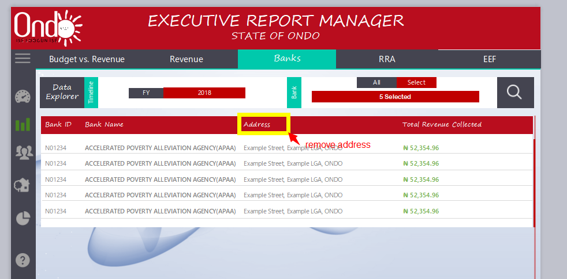
EXECUTIVE REPORT MANAGER
STATE OF ONDO
Budget vs. Revenue
Revenue
Banks
RRA
EEF
Data Explorer
Timeline
Bank
All
Select
FY
2018
5 Selected
Bank ID Bank Name Address Total Revenue Collected
N01234 ACCELERATED POVERTY ALLEVIATION AGENCY(APAA) Example Street, Example LGA, ONDO ₦ 52,354.96
N01234 ACCELERATED POVERTY ALLEVIATION AGENCY(APAA) Example Street, Example LGA, ONDO ₦ 52,354.96
N01234 ACCELERATED POVERTY ALLEVIATION AGENCY(APAA) Example Street, Example LGA, ONDO ₦ 52,354.96
N01234 ACCELERATED POVERTY ALLEVIATION AGENCY(APAA) Example Street, Example LGA, ONDO ₦ 52,354.96
N01234 ACCELERATED POVERTY ALLEVIATION AGENCY(APAA) Example Street, Example LGA, ONDO ₦ 52,354.96

Slide 14

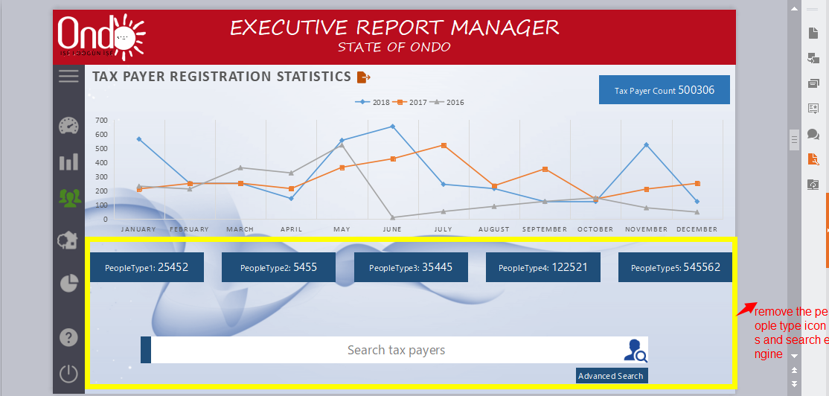

EXECUTIVE REPORT MANAGER
STATE OF ONDO
Tax Payer Count 500306
PeopleType1: 25452
PeopleType2: 5455
PeopleType3: 35445
PeopleType4: 122521
PeopleType5: 545562
Search tax payers
Advanced Search

Slide 15
EXECUTIVE REPORT MANAGER
STATE OF ONDO
Advanced Search
Payer ID
Name
Date of Birth
Type
Organization
+234 -
Phone
Email Address
Address
ORIN
TIN
Registered Between
REVENUE ITEMS
MDA
Search
NEW ADDITIONS

Slide 16

EXECUTIVE REPORT MANAGER
STATE OF ONDO
Modify Search Parameters
Payer ID Name ORIN Birth Date Reg. Date Phone Email Amount Due
2556 Jonathan Doe 1212145478 Jan 1, 1990 Jul 1, 2018 +234-7887898587 jonathandoe@example.com ₦52,354.96
Individual
2556 Jonathan Doe 1212145478 Jan 1, 1990 Jul 1, 2018 +234-7887898587 jonathandoe@example.com ₦52,354.96
Individual
2556 Jonathan Doe 1212145478 Jan 1, 1990 Jul 1, 2018 +234-7887898587 jonathandoe@example.com ₦52,354.96
Individual
2556 Jonathan Doe 1212145478 Jan 1, 1990 Jul 1, 2018 +234-7887898587 jonathandoe@example.com ₦52,354.96
Individual
2556 Jonathan Doe 1212145478 Jan 1, 1990 Jul 1, 2018 +234-7887898587 jonathandoe@example.com ₦52,354.96
Individual
2556 Jonathan Doe 1212145478 Jan 1, 1990 Jul 1, 2018 +234-7887898587 jonathandoe@example.com ₦52,354.96
Individual
2556 Jonathan Doe 1212145478 Jan 1, 1990 Jul 1, 2018 +234-7887898587 jonathandoe@example.com ₦52,354.96
Individual

Slide 17
Tax Payer Detail
Important Details
Property
Tax Folders
Payment History
Payer ID
Name
Organization
Type
Phone
Email
Address
Date of Birth
ORIN
TIN
Date of Registration
52124
Jonathan Doe
Star Corp
Individual
+234 – 7558545845, +234 – 7544525478
jonathandoe@example.com
101, Infinity Street, Ada, Ondo, Nigeria
Jan 1, 1990
1212141245
11224554556
Jul 1, 2018
Close
Print Profile

Slide 18
Tax Payer Detail
Important Details
Property
Tax Folders
Payment History
Property ID Type Address City Value Area Property RSN Area Class Land Use Amount 17 Amount 18
2656658 Residential 101, Example Street, Example LGA Akure ₦ 152,354.96 300054.25 sq. mi 2556 High Value Zone Residential ₦ 152,354.96 ₦ 152,354.96
2656658 Residential 101, Example Street, Example LGA Akure ₦ 152,354.96 300054.25 sq. mi 2556 High Value Zone Residential ₦ 152,354.96 ₦ 152,354.96
2656658 Residential 101, Example Street, Example LGA Akure ₦ 152,354.96 300054.25 sq. mi 2556 High Value Zone Residential ₦ 152,354.96 ₦ 152,354.96
2656658 Residential 101, Example Street, Example LGA Akure ₦ 152,354.96 300054.25 sq. mi 2556 High Value Zone Residential ₦ 152,354.96 ₦ 152,354.96
2656658 Residential 101, Example Street, Example LGA Akure ₦ 152,354.96 300054.25 sq. mi 2556 High Value Zone Residential ₦ 152,354.96 ₦ 152,354.96
Close

Slide 19
Tax Payer Detail
Important Details
Property
Tax Folders
Payment History
Folder ID Date Created Type Sub Type Amount Billed Amount Paid Amount Due
2556 Jul 1, 2018 ONDO Internal Revenue Service Direct Assessment ₦ 152,354.96 ₦ 52,354.96 ₦ 100,000.96
OIRS
2556 Jul 1, 2018 ONDO Internal Revenue Service Direct Assessment ₦ 152,354.96 ₦ 52,354.96 ₦ 100,000.96
OIRS
2556 Jul 1, 2018 ONDO Internal Revenue Service Direct Assessment ₦ 152,354.96 ₦ 52,354.96 ₦ 100,000.96
OIRS
2556 Jul 1, 2018 ONDO Internal Revenue Service Direct Assessment ₦ 152,354.96 ₦ 52,354.96 ₦ 100,000.96
OIRS
2556 Jul 1, 2018 ONDO Internal Revenue Service Direct Assessment ₦ 152,354.96 ₦ 52,354.96 ₦ 100,000.96
OIRS
2556 Jul 1, 2018 ONDO Internal Revenue Service Direct Assessment ₦ 152,354.96 ₦ 52,354.96 ₦ 100,000.96
OIRS
Close

Slide 20
Tax Payer Detail
Important Details
Property
Tax Folders
Payment History
Payment Number Payment Date Payment Mode Bank Receipt Number Paid By
2556 Jul 1, 2018 Cash Bank of Nigeria 252545587 Jonathan Doe
2556 Jul 1, 2018 Cash Bank of Nigeria 252545587 Jonathan Doe
2556 Jul 1, 2018 Cash Bank of Nigeria 252545587 Jonathan Doe
2556 Jul 1, 2018 Cash Bank of Nigeria 252545587 Jonathan Doe
2556 Jul 1, 2018 Cash Bank of Nigeria 252545587 Jonathan Doe
2556 Jul 1, 2018 Cash Bank of Nigeria 252545587 Jonathan Doe
2556 Jul 1, 2018 Cash Bank of Nigeria 252545587 Jonathan Doe
2556 Jul 1, 2018 Cash Bank of Nigeria 252545587 Jonathan Doe
Close

Slide 21
State of Ondo
Internal Revenue Service
Confidential
Tax Payer Details
Payer ID
Name
Organization
Type
Phone
Email
Address
Date of Birth
ORIN
TIN
Date of Registration
52124
Jonathan Doe
Star Corp
Individual
+234 – 7558545845, +234 – 7544525478
jonathandoe@example.com
101, Infinity Street, Ada, Ondo, Nigeria
Jan 1, 1990
1212141245
11224554556
Jul 1, 2018
Property Owned
Property ID Type Address City Value Area Property RSN Area Class Land Use Amount 17 Amount 18
2656658 Residential 101, Example Street, Example LGA Akure ₦ 152,354.96 300054.25 sq. mi 2556 High Value Zone Residential ₦ 152,354.96 ₦ 152,354.96
2656658 Residential 101, Example Street, Example LGA Akure ₦ 152,354.96 300054.25 sq. mi 2556 High Value Zone Residential ₦ 152,354.96 ₦ 152,354.96 2656658 Residential 101, Example Street, Example LGA Akure ₦ 152,354.96 300054.25 sq. mi 2556 High Value Zone Residential ₦ 152,354.96 ₦ 152,354.96 2656658 Residential 101, Example Street, Example LGA Akure ₦ 152,354.96 300054.25 sq. mi 2556 High Value Zone Residential ₦ 152,354.96 ₦ 152,354.96 2656658 Residential 101, Example Street, Example LGA Akure ₦ 152,354.96 300054.25 sq. mi 2556 High Value Zone Residential ₦ 152,354.96 ₦ 152,354.96

Slide 22
Tax Folders
Folder ID Date Created Type Sub Type Amount Billed Amount Paid Amount Due
2556 Jul 1, 2018 ONDO Internal Revenue Service Direct Assessment ₦ 152,354.96 ₦ 52,354.96 ₦ 100,000.96
OIRS
2556 Jul 1, 2018 ONDO Internal Revenue Service Direct Assessment ₦ 152,354.96 ₦ 52,354.96 ₦ 100,000.96
OIRS
2556 Jul 1, 2018 ONDO Internal Revenue Service Direct Assessment ₦ 152,354.96 ₦ 52,354.96 ₦ 100,000.96
OIRS
2556 Jul 1, 2018 ONDO Internal Revenue Service Direct Assessment ₦ 152,354.96 ₦ 52,354.96 ₦ 100,000.96
OIRS
2556 Jul 1, 2018 ONDO Internal Revenue Service Direct Assessment ₦ 152,354.96 ₦ 52,354.96 ₦ 100,000.96
OIRS
Payment History
Payment Number Payment Date Payment Mode Bank Receipt Number Paid By
2556 Jul 1, 2018 Cash Bank of Nigeria 252545587 Jonathan Doe
2556 Jul 1, 2018 Cash Bank of Nigeria 252545587 Jonathan Doe
2556 Jul 1, 2018 Cash Bank of Nigeria 252545587 Jonathan Doe
2556 Jul 1, 2018 Cash Bank of Nigeria 252545587 Jonathan Doe

Slide 23
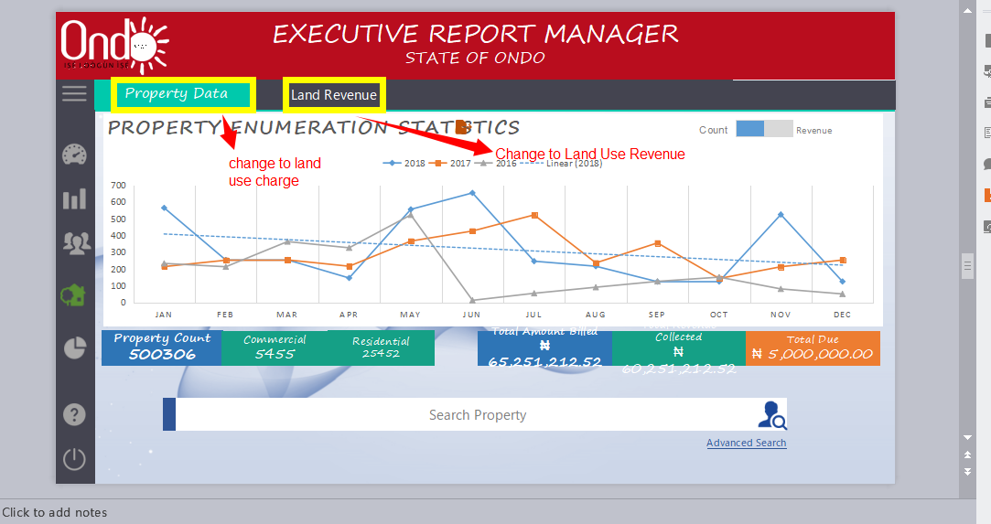
EXECUTIVE REPORT MANAGER
STATE OF ONDO
Property Data
Land Revenue
Property Count 500306
Commercial
5455
Residential
25452
Total Amount Billed
₦ 65,251,212.52
Total Revenue Collected
₦ 60,251,212.52
Total Due
₦ 5,000,000.00
Search Property
Advanced Search

Slide 24
EXECUTIVE REPORT MANAGER
STATE OF ONDO
Property Data
Land Revenue
Property Count 500306
Commercial
5455
Residential
25452
Total Amount Billed
₦ 65,251,212.52
Total Revenue Collected
₦ 60,251,212.52
Total Due
₦ 5,000,000.00
Search Property
Advanced Search

Slide 25
EXECUTIVE REPORT MANAGER
STATE OF ONDO
Advanced Search
Property ID
Reg. Date
Property Value (₦)
Area (sq. mi.)
House No.
Street Type
2000000
4000000
35655.2
45445.35
Street Address
City
LGA
Search

Slide 26
EXECUTIVE REPORT MANAGER
STATE OF ONDO
Modify Search Parameters
Property RSN Property ID Type Address City LGA Value Area Owner Amount Due
2556 2656658 Residential 101, Example Street, Example LGA Akure Akure ₦ 152,354.96 3004.25 sq. mi Jonathan Doe ₦ 152,354.96
2556 2656658 Residential 101, Example Street, Example LGA Akure Akure ₦ 152,354.96 3004.25 sq. mi Jonathan Doe ₦ 152,354.96
2556 2656658 Residential 101, Example Street, Example LGA Akure Akure ₦ 152,354.96 3004.25 sq. mi Jonathan Doe ₦ 152,354.96
2556 2656658 Residential 101, Example Street, Example LGA Akure Akure ₦ 152,354.96 3004.25 sq. mi Jonathan Doe ₦ 152,354.96
2556 2656658 Residential 101, Example Street, Example LGA Akure Akure ₦ 152,354.96 3004.25 sq. mi Jonathan Doe ₦ 152,354.96
2556 2656658 Residential 101, Example Street, Example LGA Akure Akure ₦ 152,354.96 3004.25 sq. mi Jonathan Doe ₦ 152,354.96

Slide 27
EXECUTIVE REPORT MANAGER
STATE OF ONDO
Property Data
Land Revenue
2018
Total Amount Billed
₦ 65,251,212.52
Total Revenue Collected
₦ 60,251,212.52
Total Due
₦ 5,000,000.00
Bill Number Billed Date Due Date Created By Bill Description Property ID Billed Amount Total Paid Status
2556 Jul 21, 2018 Aug 21, 2018 Jane Doe (Officer) 17 000535 000 00 OPL 115845 ₦ 152,354.96 ₦ 152,354.96
2556 Jul 21, 2018 Aug 21, 2018 Jane Doe (Officer) 17 000535 000 00 OPL 115845 ₦ 152,354.96 ₦ 0.00
Paid
Not Paid

Slide 28
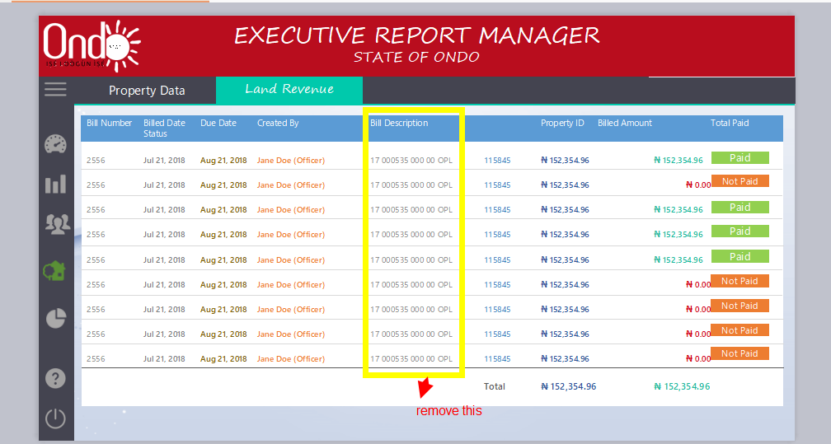
EXECUTIVE REPORT MANAGER
STATE OF ONDO
Property Data
Land Revenue
Bill Number Billed Date Due Date Created By Bill Description Property ID Billed Amount Total Paid Status
2556 Jul 21, 2018 Aug 21, 2018 Jane Doe (Officer) 17 000535 000 00 OPL 115845 ₦ 152,354.96 ₦ 152,354.96
2556 Jul 21, 2018 Aug 21, 2018 Jane Doe (Officer) 17 000535 000 00 OPL 115845 ₦ 152,354.96 ₦ 0.00
2556 Jul 21, 2018 Aug 21, 2018 Jane Doe (Officer) 17 000535 000 00 OPL 115845 ₦ 152,354.96 ₦ 152,354.96
2556 Jul 21, 2018 Aug 21, 2018 Jane Doe (Officer) 17 000535 000 00 OPL 115845 ₦ 152,354.96 ₦ 152,354.96
2556 Jul 21, 2018 Aug 21, 2018 Jane Doe (Officer) 17 000535 000 00 OPL 115845 ₦ 152,354.96 ₦ 152,354.96
2556 Jul 21, 2018 Aug 21, 2018 Jane Doe (Officer) 17 000535 000 00 OPL 115845 ₦ 152,354.96 ₦ 0.00
2556 Jul 21, 2018 Aug 21, 2018 Jane Doe (Officer) 17 000535 000 00 OPL 115845 ₦ 152,354.96 ₦ 0.00
2556 Jul 21, 2018 Aug 21, 2018 Jane Doe (Officer) 17 000535 000 00 OPL 115845 ₦ 152,354.96 ₦ 0.00
2556 Jul 21, 2018 Aug 21, 2018 Jane Doe (Officer) 17 000535 000 00 OPL 115845 ₦ 152,354.96 ₦ 0.00
Total ₦ 152,354.96 ₦ 152,354.96
Paid
Not Paid
Paid
Paid
Paid
Not Paid
Not Paid
Not Paid
Not Paid

Slide 29
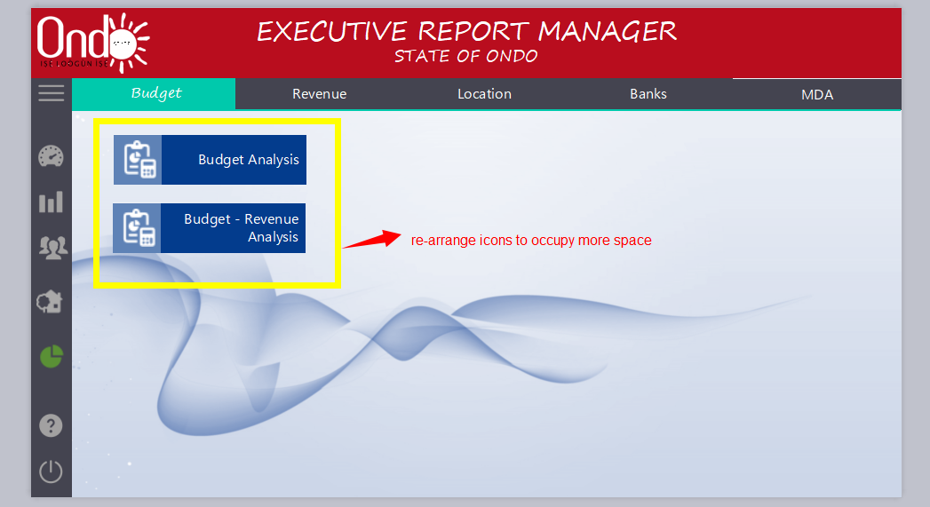
EXECUTIVE REPORT MANAGER
STATE OF ONDO
Budget
Revenue
Location
Banks
MDA
Budget Analysis
Budget - Revenue Analysis

Slide 30
EXECUTIVE REPORT MANAGER
STATE OF ONDO
Budget
Revenue
Location
Banks
MDA
Budget Analysis
FY
MDA
MDA Yearly Budget Monthly Budget
ACCELERATED POVERTY ALLEVIATION AGENCY(APAA) ₦ 152,354.96 ₦ 52,354.96
ACCELERATED POVERTY ALLEVIATION AGENCY(APAA) ₦ 152,354.96 ₦ 52,354.96
ACCELERATED POVERTY ALLEVIATION AGENCY(APAA) ₦ 152,354.96 ₦ 52,354.96
ACCELERATED POVERTY ALLEVIATION AGENCY(APAA) ₦ 152,354.96 ₦ 52,354.96
ACCELERATED POVERTY ALLEVIATION AGENCY(APAA) ₦ 152,354.96 ₦ 52,354.96

Slide 31
EXECUTIVE REPORT MANAGER
STATE OF ONDO
Budget
Revenue
Location
Banks
MDA
Budget - Revenue Analysis
Yearly
Quarterly
Monthly
FY
MDA
MDA Budget Revenue Generated Arrears Total Revenue Generated
ACCELERATED POVERTY ALLEVIATION AGENCY(APAA) ₦ 152,354.96 ₦ 52,354.96 ₦ 52,354.96 ₦ 52,354.96
ACCELERATED POVERTY ALLEVIATION AGENCY(APAA) ₦ 152,354.96 ₦ 52,354.96 ₦ 52,354.96 ₦ 52,354.96
ACCELERATED POVERTY ALLEVIATION AGENCY(APAA) ₦ 152,354.96 ₦ 52,354.96 ₦ 52,354.96 ₦ 52,354.96
ACCELERATED POVERTY ALLEVIATION AGENCY(APAA) ₦ 152,354.96 ₦ 52,354.96 ₦ 52,354.96 ₦ 52,354.96
ACCELERATED POVERTY ALLEVIATION AGENCY(APAA) ₦ 152,354.96 ₦ 52,354.96 ₦ 52,354.96 ₦ 52,354.96

Slide 32
EXECUTIVE REPORT MANAGER
STATE OF ONDO
Budget
Revenue
Location
Banks
MDA
Budget - Revenue Analysis
Yearly
Quarterly
Monthly
Quarter
Quarter 1
MDA
MDA Quarterly Budget Revenue Generated Arrears Total Revenue Generated
ACCELERATED POVERTY ALLEVIATION AGENCY(APAA) ₦ 152,354.96 ₦ 52,354.96 ₦ 52,354.96 ₦ 52,354.96
ACCELERATED POVERTY ALLEVIATION AGENCY(APAA) ₦ 152,354.96 ₦ 52,354.96 ₦ 52,354.96 ₦ 52,354.96
ACCELERATED POVERTY ALLEVIATION AGENCY(APAA) ₦ 152,354.96 ₦ 52,354.96 ₦ 52,354.96 ₦ 52,354.96
ACCELERATED POVERTY ALLEVIATION AGENCY(APAA) ₦ 152,354.96 ₦ 52,354.96 ₦ 52,354.96 ₦ 52,354.96
ACCELERATED POVERTY ALLEVIATION AGENCY(APAA) ₦ 152,354.96 ₦ 52,354.96 ₦ 52,354.96 ₦ 52,354.96

Slide 33
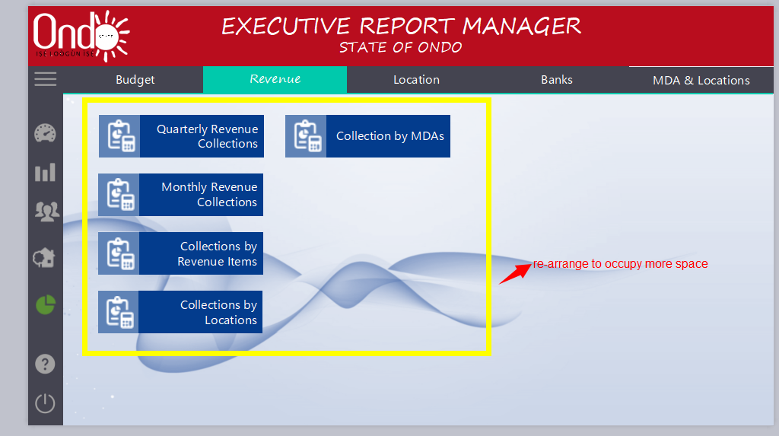
EXECUTIVE REPORT MANAGER
STATE OF ONDO
Budget
Revenue
Location
Banks
MDA & Locations
Quarterly Revenue Collections
Collection by MDAs
Monthly Revenue Collections
Collections by Revenue Items
Collections by Locations

Slide 34
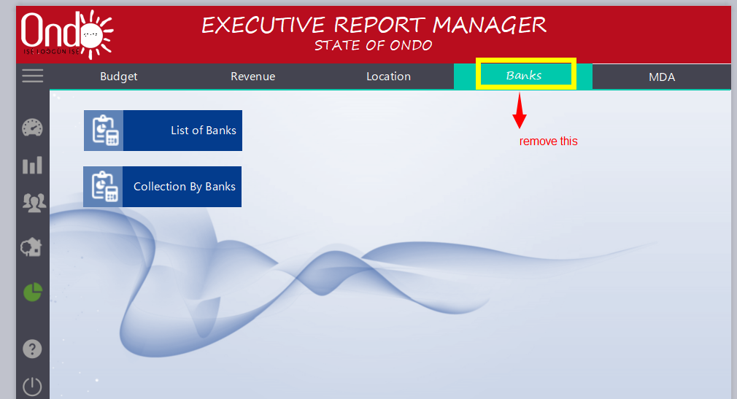
EXECUTIVE REPORT MANAGER
STATE OF ONDO
Budget
Revenue
Location
Banks
MDA
List of Banks
Collection By Banks

Slide 35
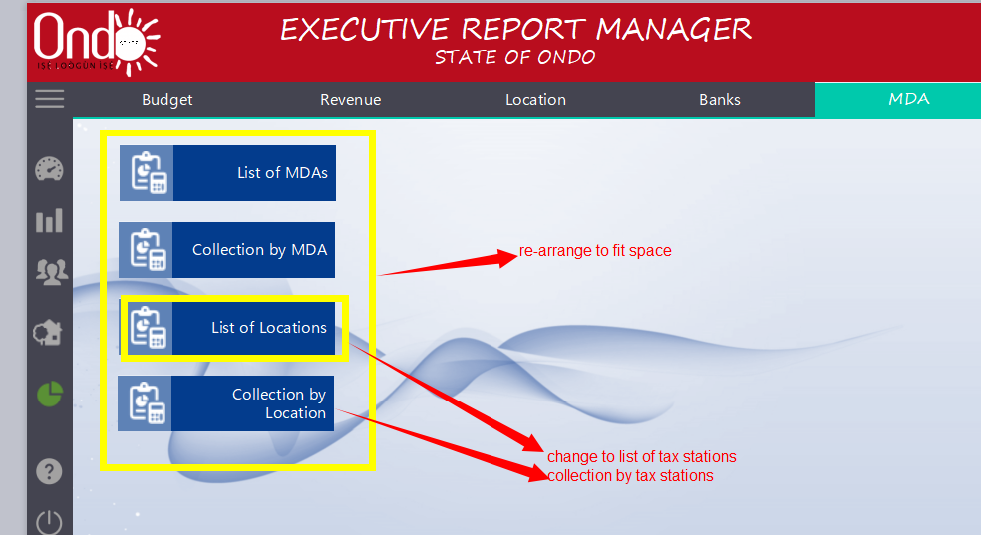
EXECUTIVE REPORT MANAGER
STATE OF ONDO
Budget
Revenue
Location
Banks
MDA
List of MDAs
Collection by MDA
List of Locations
Collection by Location

Slide 36
EXECUTIVE REPORT MANAGER
STATE OF ONDO
Budget
Revenue
Location
Banks
MDA
MDAs
FY
2018
MDA
All
MDA Yearly Budget Revenue Generated Performance Rank
ACCELERATED POVERTY ALLEVIATION AGENCY(APAA) ₦ 152,354.96 ₦ 52,354.96 85.65 % 1
ACCELERATED POVERTY ALLEVIATION AGENCY(APAA) ₦ 152,354.96 ₦ 52,354.96 85.65 % 1
ACCELERATED POVERTY ALLEVIATION AGENCY(APAA) ₦ 152,354.96 ₦ 52,354.96 85.65 % 1
ACCELERATED POVERTY ALLEVIATION AGENCY(APAA) ₦ 152,354.96 ₦ 52,354.96 85.65 % 1
ACCELERATED POVERTY ALLEVIATION AGENCY(APAA) ₦ 152,354.96 ₦ 52,354.96 85.65 % 1

Slide 37


